Slide 1






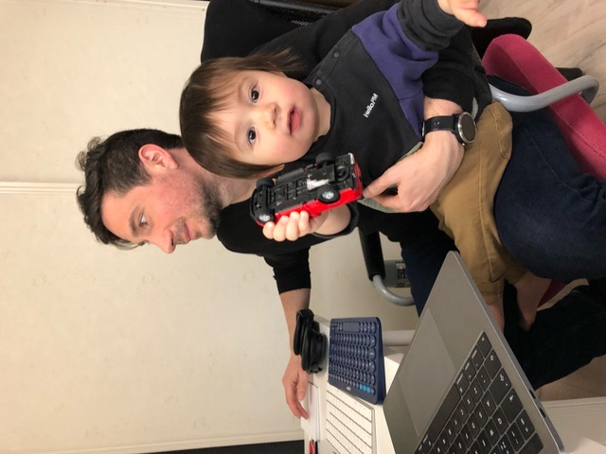
Understanding attitudes, experience and risk factors for domestic violence
International Team of Scientists working at JAMSTEC, Japan
Prima Anugerahanti
Indonesia
Gerlien Verhaegen
Belgium
Heather Ritchie
Scotland
Arthur Bauville
France
Ettore Barbieri
Italy

Slide 2

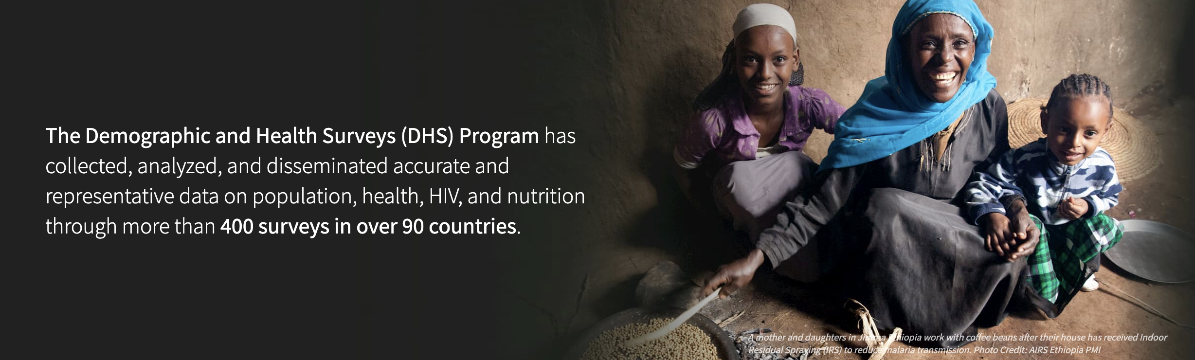
Using data provided by the DHS Program we wanted to:
Investigate the acceptance vs the experience of domestic violence
Determine the controlling factors of domestic violence
Develop a tool that would quickly and efficiently identify women who are at risk of domestic violence

Slide 3
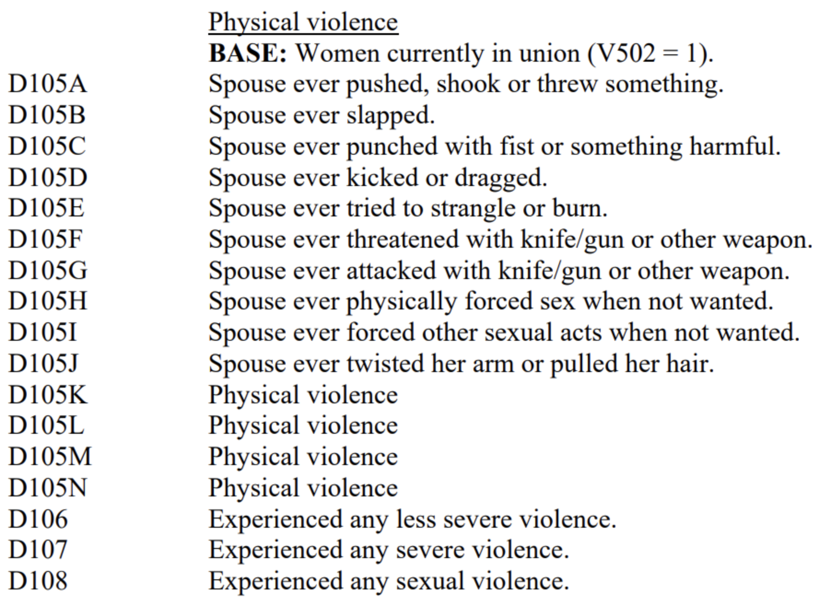
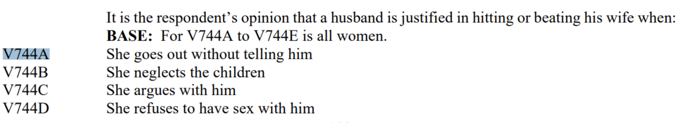
DHS Program data for acceptance and experience of domestic violence
Acceptance: % of yes to at least one answer of:
Experience: % of yes to at least one answer of:

Slide 4

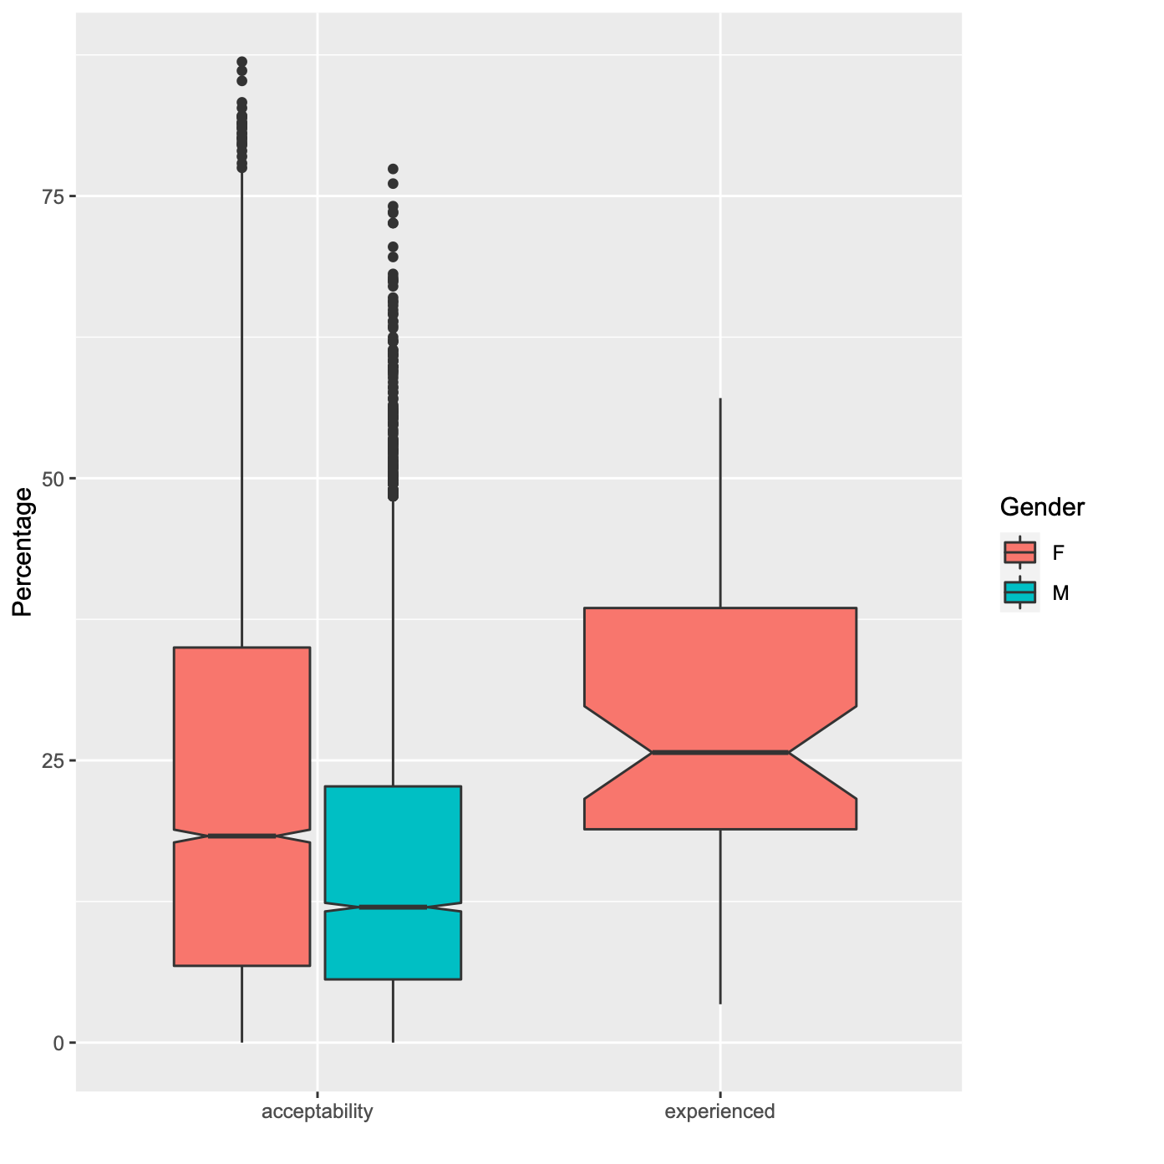
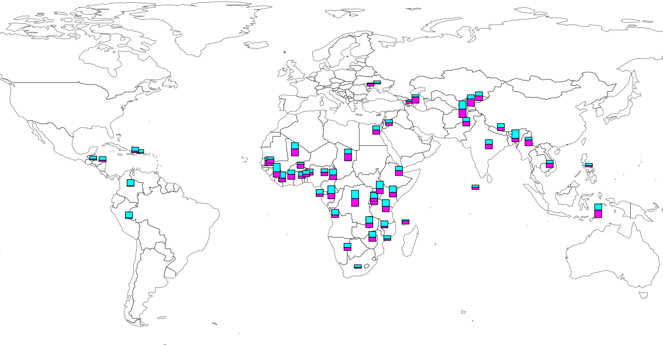
Acceptance vs experience of domestic violence
Acceptance
Experience
Domestic violence is widespread amongst the countries surveyed by the DHS
On average across all countries 26% of women surveyed have experienced physical and/or sexual domestic violence
Overall more women than men agreed that domestic violence was acceptable in certain circumstance

Slide 5
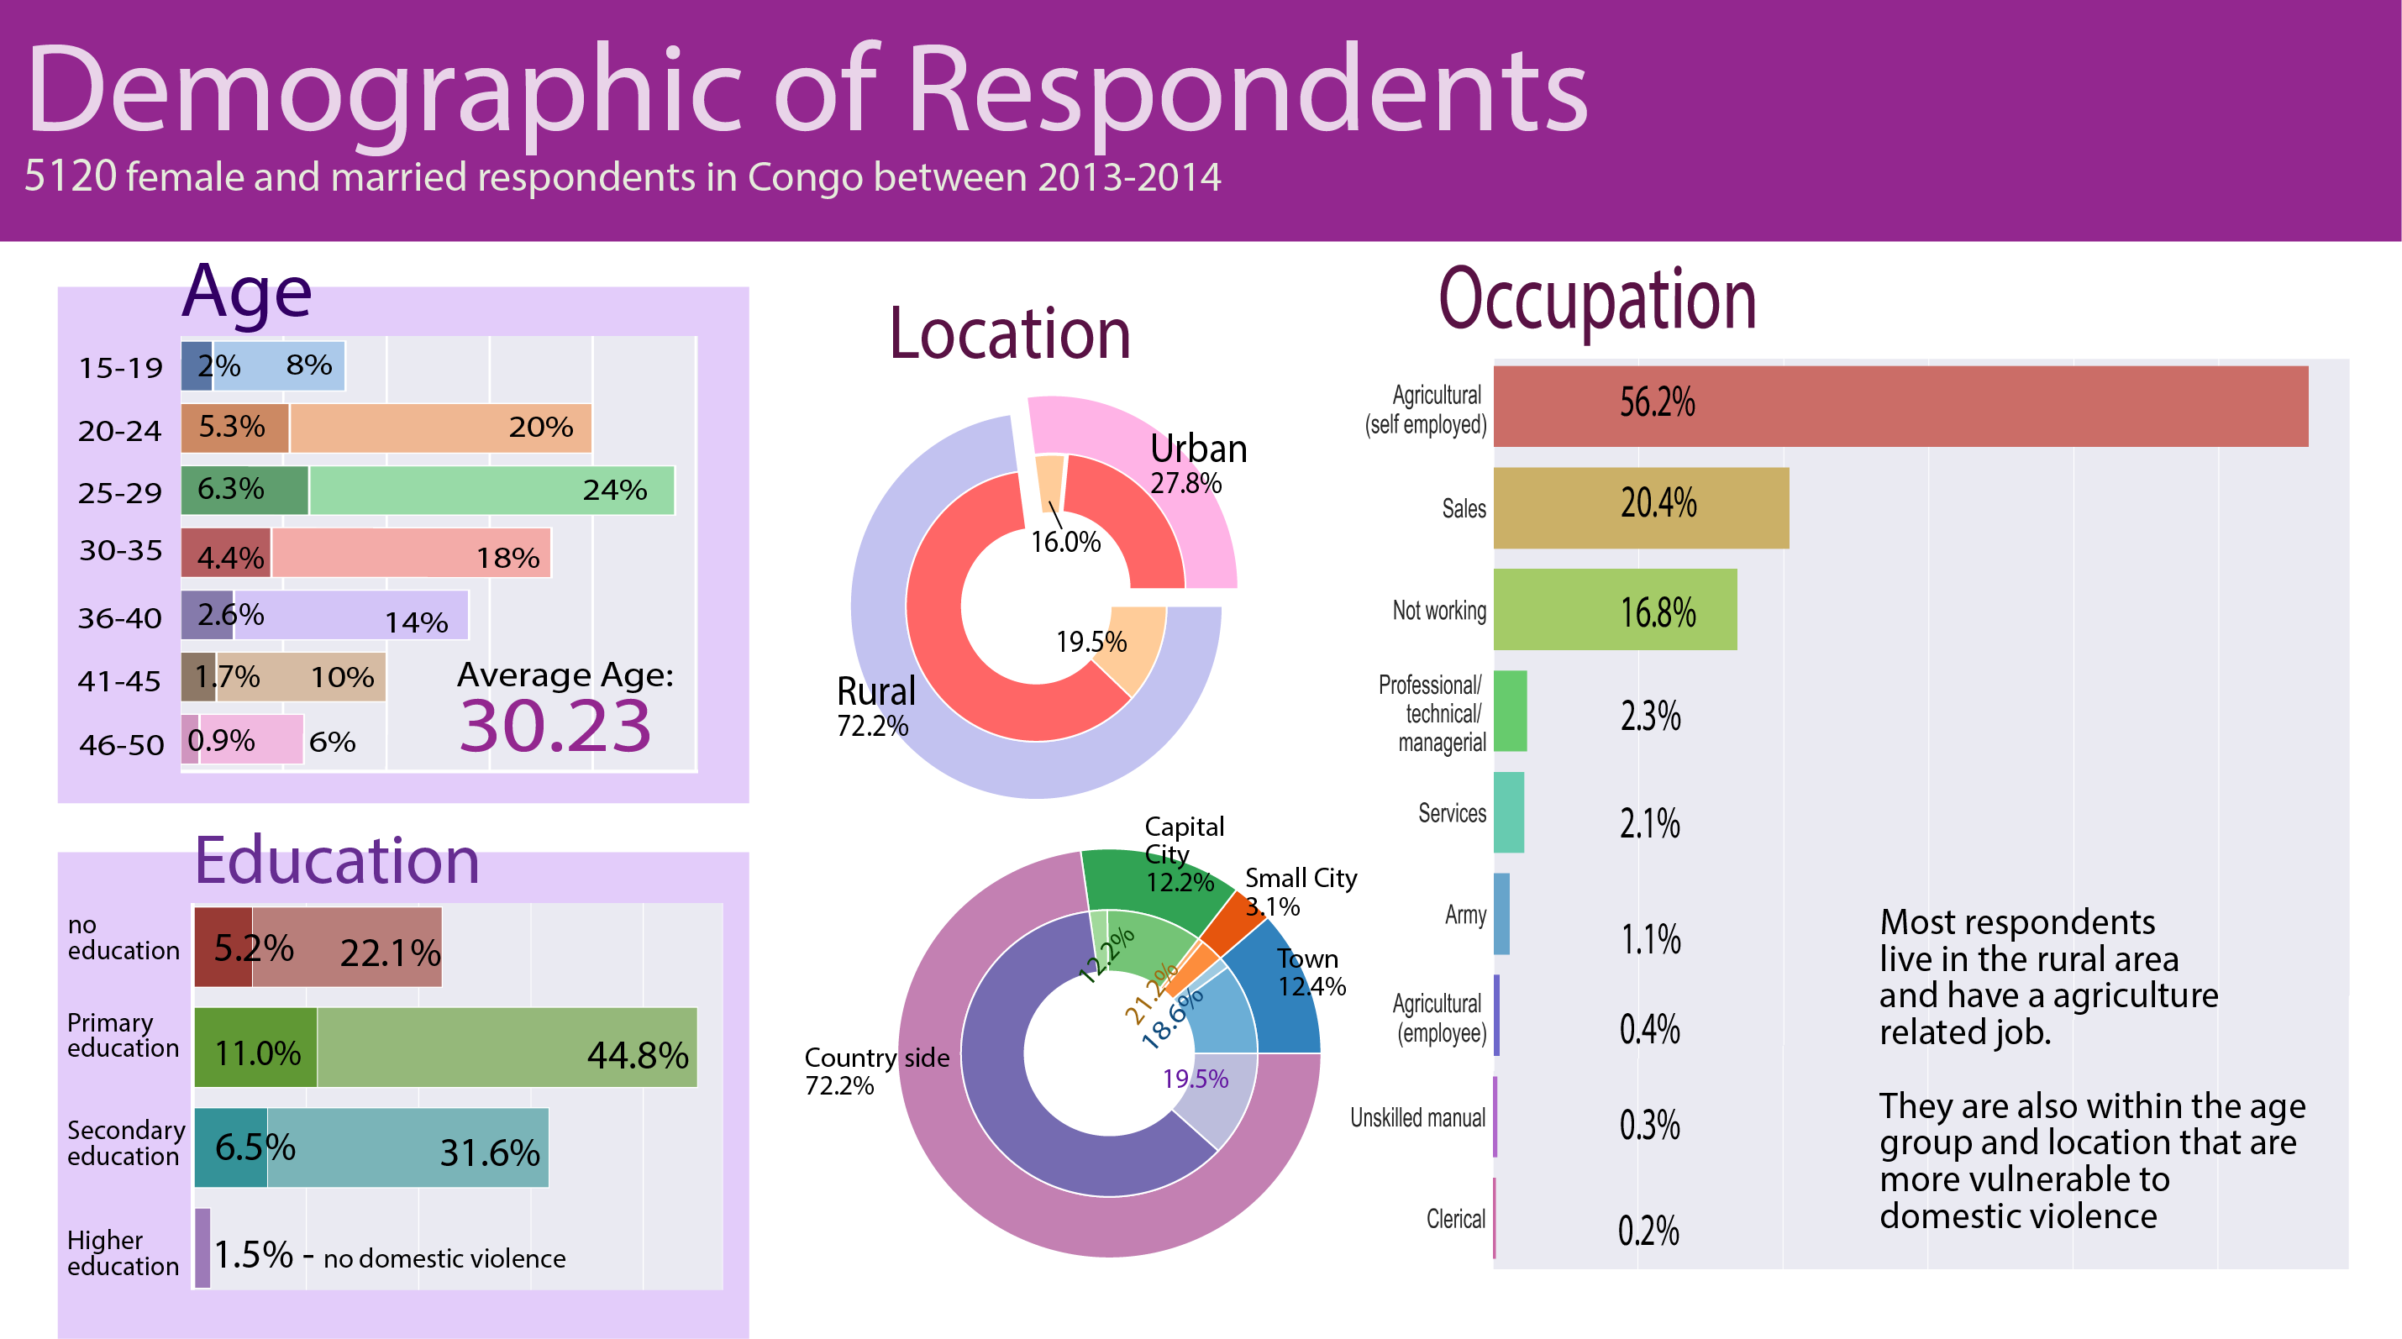

Slide 6
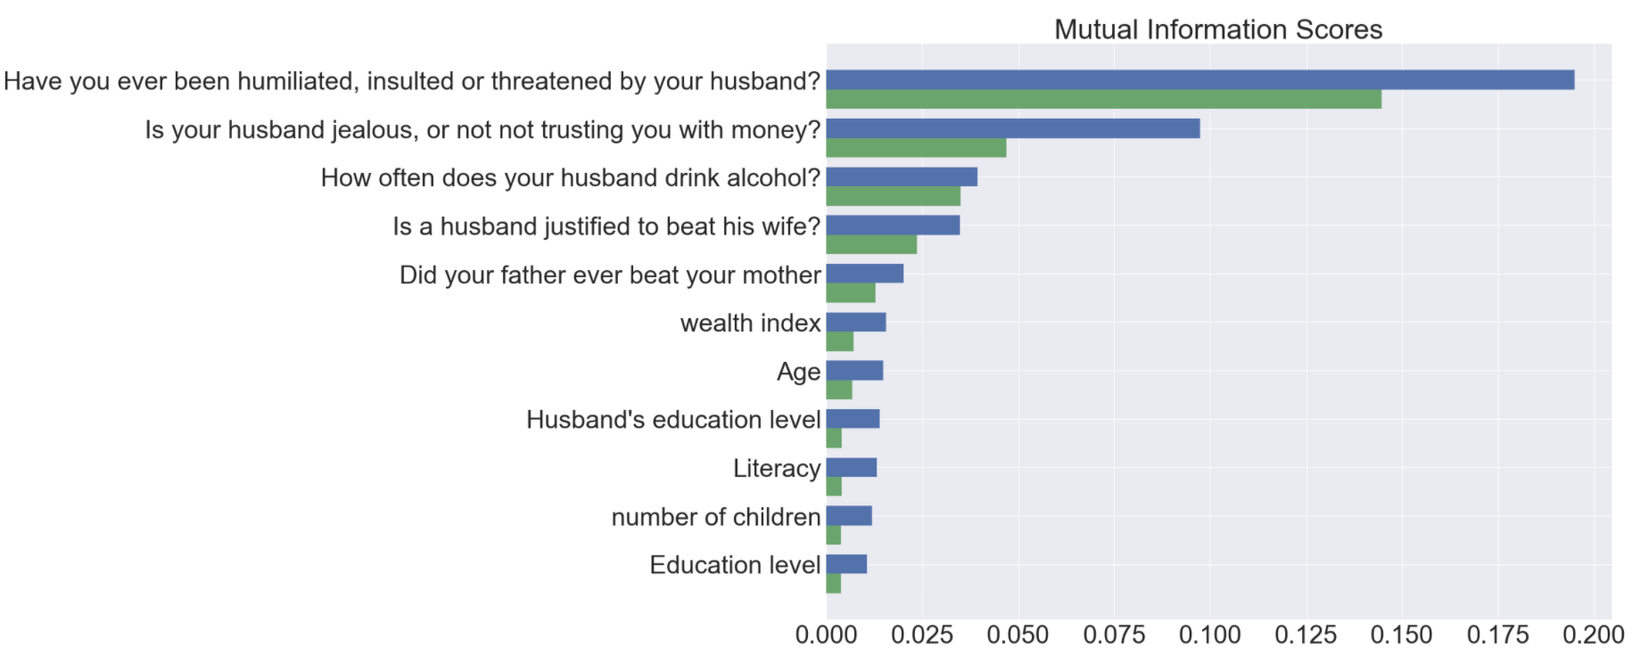
What to ask to detect early signs of
domestic violence?
From which information can we predict answers to the question: “Have you experienced physical or domestic violence in the last 12 months?”
Benin
Emotional violence:
Control issues:
Congo
Alcohol consumption:
Acceptance of violence:
Family history:
Demographics:

Slide 7
In Benin it seems that emotional violence occurs before physical violence and therefore we may be able to identify women at risk
In Congo
Is emotional violence predictive of physical/sexual violence
Benin
Congo
A
B
Physical Violence 4.52%
Emotional Violence 9.94%
Physical Violence 18.52%
Emotional Violence
14.02%
(Benin) 63%
(Congo) 51%
$$P(B|A)$$
of women experiencing physical violence also experience emotional violence
(Benin) 29%
(Congo) 67%
$$P(A|B)$$
of women experiencing emotional violence also experience physical violence
In both countries emotional and physical violence are correlated but emotional violence seems to be a precursor of physical/sexual violence only in Benin

Slide 8
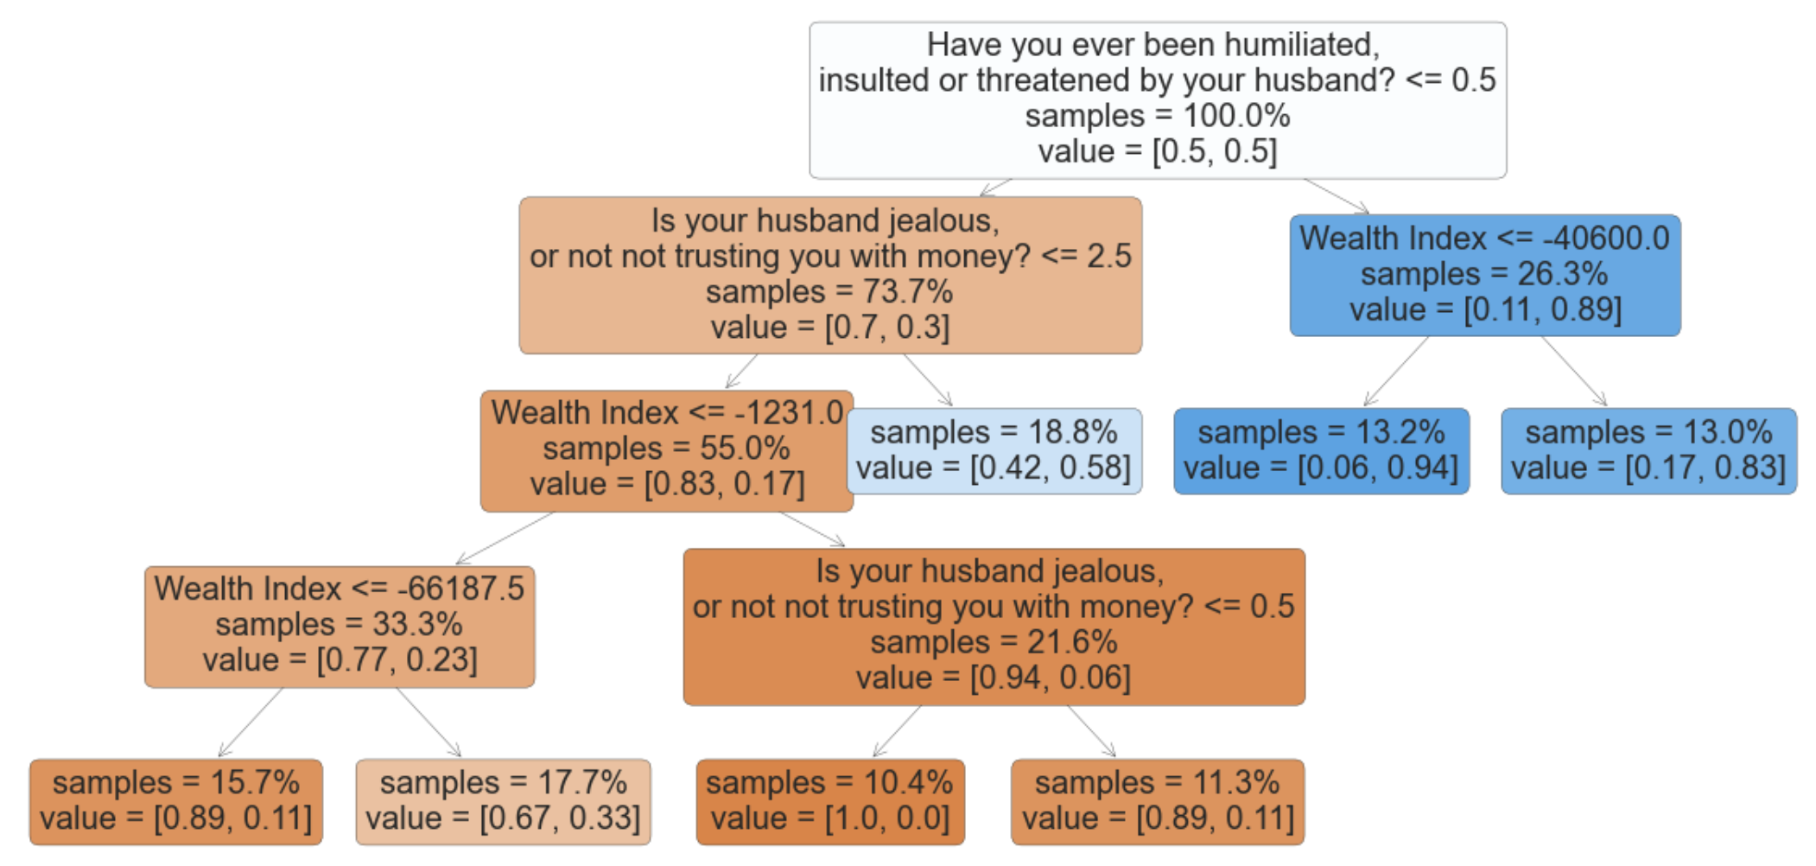
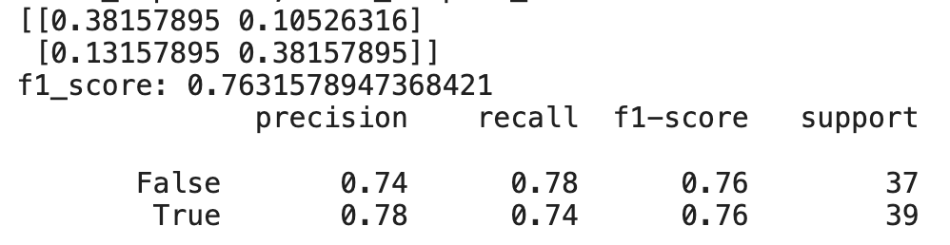
How well can we identify women at risk of physical violence?
Decision tree: doesn’t require a computer (paper, dialogue)
Hyperparameters were tuned to optimize recall because:
True positives are women in danger (experiencing physical or sexual violence)
False negatives are women in danger but not detected (should be minimized)
False positives are women who are not experiencing physical violence but may in the future
$$recall=\frac{truepositives}{truepositives+falsenegatives}$$

Slide 10
Which questions to ask to detect early signs of domestic violence?
Decision tree: doesn’t require a computer (paper, dialogue)
Hyperparameters were tuned to optimize recall because:
True positives are women in danger (experiencing physical or sexual violence)
False negatives are women in danger but not detected (should be minimized)
False positives are women who are not experiencing physical violence but may in the future
$$recall=\frac{truepositives}{truepositives+falsenegatives}$$
We aim to predict whether a woman is susceptible to experience domestic violence
We want a diagnostic test that can be performed in less than two minutes either automatically, on paper, or given by a non-expert.
We chose a decision-tree for its “white-box” approach. The decision-tree proposes a short series of questions. Each new question is personalized in function of the previous answer, so that the size of the questionnaire can be really small.
We obtain reasonnably good results by asking less than five questions

Slide 12
Predictive features

Slide 13



Can we use these data to predict which women are at most risk of future violence?

Slide 14
Conclusion

Slide 15
MI scores Congo vs Benin
Benin
Congo

Slide 16

Diagnostic tool
Goal: identify women at risk of domestic violence as part of routine task
The DHS program questionnaire is very long (>50 pages). It cannot be performed casually, but it may already contain the right questions for a quick diagnostic
We use a decision tree classification model:
short personalized questionnaire
implementable without computer by a non-expert (i.e. deployable in developing countries)
Test under 2 minutes (less than 5 questions) -> the test can be taken during routine visit to the doctor or administration, even in the presence of the husband
Ideally, the model should be universal and predictive
Notes:
How proposition to help reduce domestic violence is to provide a tool to diagnose under 1 minute women at risk

Slide 17
Probabilities for accepting types of domestic violence
Case Study 1 - BENIN
Received
Physical Violence 4.52%
Received Emotional Violence 9.94%
Think Violence is Acceptable 31.6%
Think Violence is Acceptable 31.6%
$$40.62\%$$
Probability of Accepting violence after experiencing emotional violence
$$47.09\%$$
Probability of Accepting violence after experiencing physical violence

Slide 18
Probabilities for accepting types of domestic violence
Case Study 2 - CONGO
Received Emotional Violence 14.02%
Think Violence is Acceptable 75.49%
Received
Physical Violence 18.52%
Think Violence is Acceptable 75.49%
$$86.63\%$$
Probability of Accepting violence after experiencing emotional violence
$$87.24\%$$
Probability of Accepting violence after experiencing physical violence

Slide 19
Probabilities for experiencing types of domestic violence
Case Study 2 - CONGO
Received Both
9.36%
Received Emotional Violence
14.02%
Received Physical Violence 18.52%
$$50.53\%$$
Probability of Experiencing Emotional violence after experiencing physical violence
$$P\left(B | A\right)=\frac{P\left(A∩B\right)}{P\left(A\right)}=$$
BAYES’ Theorem
66.71%
Probability of Experiencing physical violence after experiencing emotional violence
$$P\left(A | B\right)=\frac{P\left(B|A\right)P(A)}{P\left(B\right)}=$$

Slide 20
Probabilities for experiencing types of domestic violence
Case Study 1 - BENIN
Received Both
2.84%
Received Physical Violence 4.52%
Received Emotional Violence 9.94%
$$62.96\%$$
Probability of Experiencing Emotional violence after experiencing physical violence
$$P\left(B | A\right)=\frac{P\left(A∩B\right)}{P\left(A\right)}=$$
BAYES’ Theorem
28.61%
Probability of Experiencing physical violence after experiencing emotional violence
$$P\left(A | B\right)=\frac{P\left(B|A\right)P(A)}{P\left(B\right)}=$$

Slide 21

Code
dat <- read.csv("acceptability_vs_experienced_vs_gender.csv")
library(ggplot2)
ggplot(dat, aes(x = Category, y = Value))+
geom_boxplot(aes(fill = Gender),notch=TRUE,las=2)+
labs(y="Percentage", x="")

Slide 22
Code
library(rworldmap)
mapBars( dat,nameX="lon", nameY="lat",
nameZs=c('acceptability','experienced'),barWidth = 3,
borderCol= "grey17", zColours = c("magenta","cyan"))

